Slide 1
Chapter 10 Linked Lists, Stacks, Queues, and Priority Queues

Slide 2
What is a Data Structure?
A data structure is a collection of data organized in some fashion. A data structure not only stores data, but also supports the operations for manipulating data in the structure.

Slide 3
Object-Oriented Data Structure
In object-oriented thinking, a data structure is an object that stores other objects, referred to as data or elements.
To define a data structure is essentially to declare a class.
The class for a data structure should use data fields to store data and provide methods to support operations such as insertion and deletion.
To create a data structure is therefore to create an instance from the class. You can then apply the methods on the instance to manipulate the data structure such as inserting an element to the data structure or deleting an element from the data structure.

Slide 4
Four Classic Data Structures
Four classic dynamic data structures to be introduced in this chapter are lists, stacks, queues, and priority queues.
A list is a collection of data stored sequentially. It supports insertion and deletion anywhere in the list.
A stack can be perceived as a special type of the list where insertions and deletions take place only at the one end, referred to as the top of a stack.
A queue represents a waiting list, where insertions take place at the back (also referred to as the tail of) of a queue and deletions take place from the front (also referred to as the head of) of a queue.
In a priority queue, elements are assigned with priorities. When accessing elements, the element with the highest priority is removed first.

Slide 5
Lists
A list is a popular data structure to store data in sequential order. For example, a list of students, a list of available rooms, a list of cities, and a list of books, etc. can be stored using lists. The common operations on a list are usually the following:
· Retrieve an element from this list.
· Insert a new element to this list.
· Delete an element from this list.
· Find how many elements are in this list.
· Find if an element is in this list.
· Find if this list is empty.

Slide 6
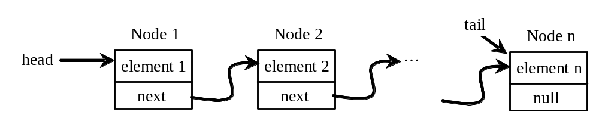
Nodes in Linked Lists
A linked list consists of nodes. Each node contains an element, and each node is linked to its next neighbor. Thus a node can be defined as a class, as follows:
class Node:
def __init__(self, element):
self.element = element
self.next = None

Slide 7
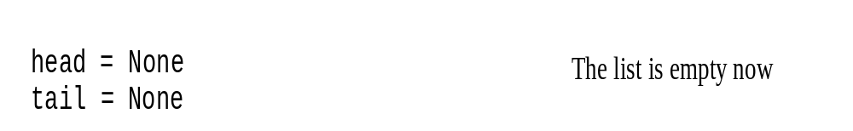
Adding Three Nodes
The variable head refers to the first node in the list, and the variable tail refers to the last node in the list.
If the list is empty, both are None. For example, you can create three nodes to store three strings in a list, as follows:
Step 1: Declare head and tail:

Slide 8
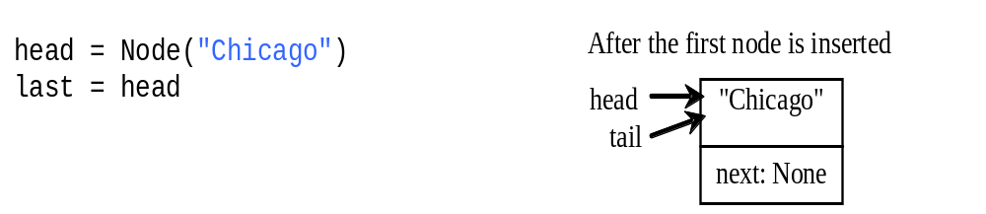
Adding Three Nodes, cont.
Step 2: Create the first node and insert it to the list:

Slide 9
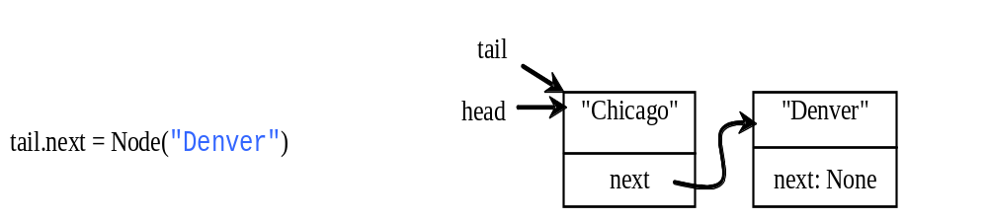
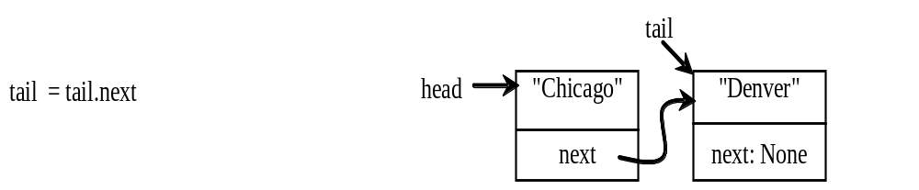
Adding Three Nodes, cont.
Step 3: Create the second node and insert it to the list:

Slide 10
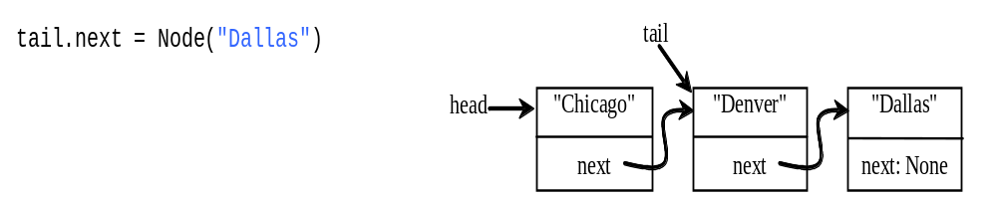
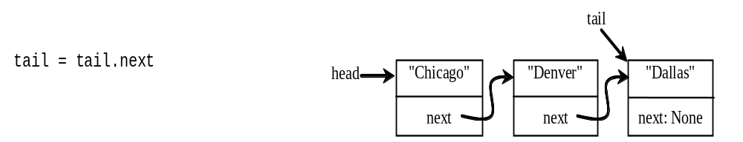
Adding Three Nodes, cont.
Step 4: Create the third node and insert it to the list:

Slide 11
Traversing All Elements in the List
Each node contains the element and a data field named next that points to the next element. If the node is the last in the list, its pointer data field next contains the value None.
You can use this property to detect the last node. For example, you may write the following loop to traverse all the nodes in the list.
current = head
while current != None:
print(current.element)
current = current.next

Slide 12
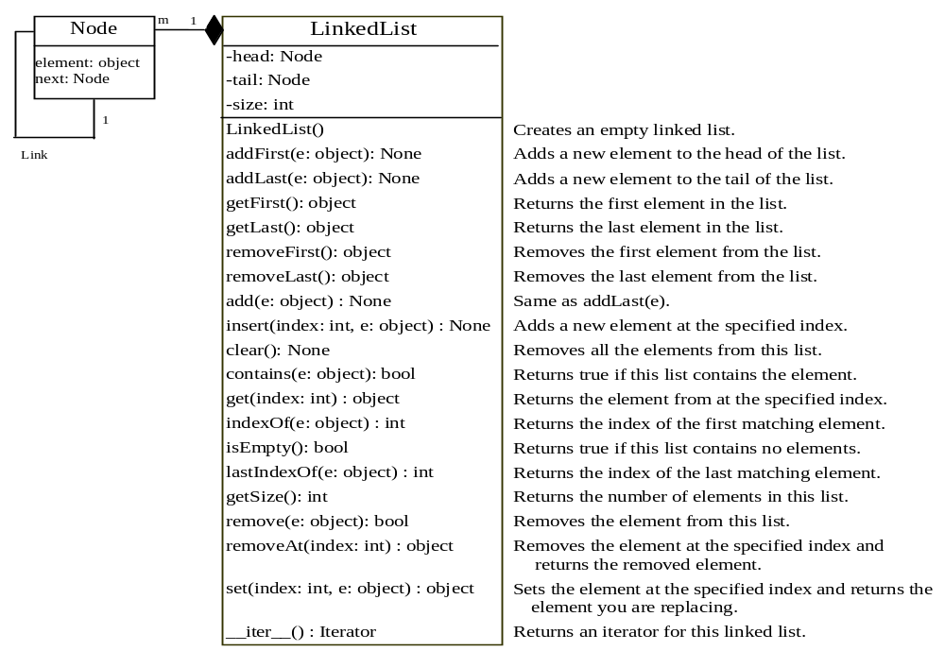
LinkedList

Slide 13
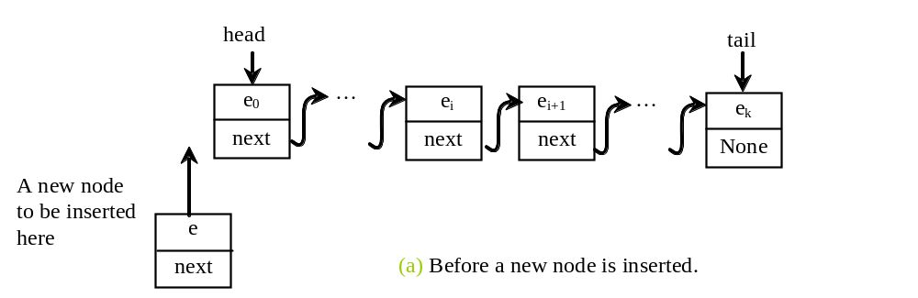
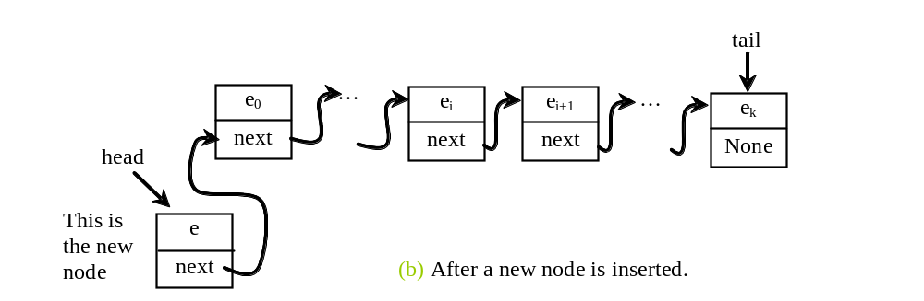
Implementing addFirst(e)
def addFirst(self, e):
newNode = Node(e) # Create a new node
newNode.next = self.__head # link the new node with the head
self.__head = newNode # head points to the new node
self.__size += 1 # Increase list size
if self.__tail == None: # the new node is the only node in list
self.__tail = self.__head

Slide 14
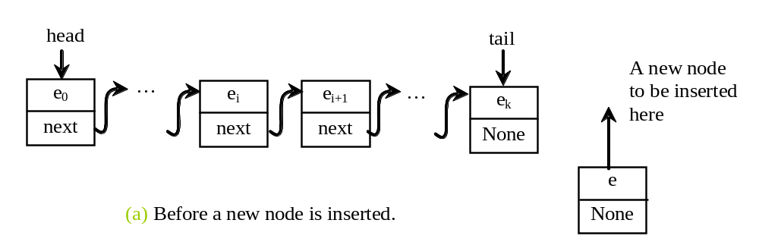
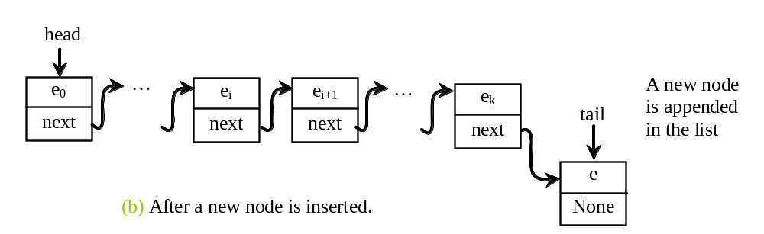
Implementing addLast(e)
def addLast(self, e):
newNode = Node(e) # Create a new node for e
if self.__tail == None:
self.__head = self.__tail = newNode # The only node in list
else:
self.__tail.next = newNode # Link the new with the last node
self.__tail = self.__tail.next # tail now points to the last node
self.__size += 1 # Increase size

Slide 15
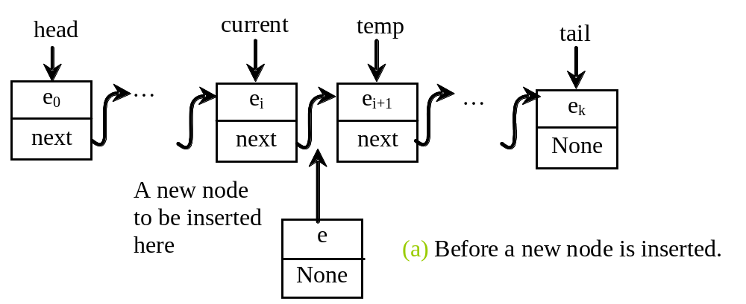
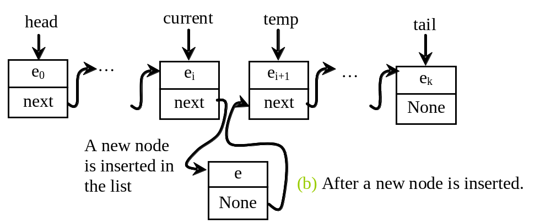
Implementing add(index, e)
def insert(self, index, e):
if index == 0:
self.addFirst(e) # Insert first
elif index >= size:
self.addLast(e) # Insert last
else: # Insert in the middle
current = head
for i in range(1, index):
current = current.next # Traverse to the desired position
temp = current.next # Save the reference to the next node
current.next = Node(e) # Insert the new node after 'current
(current.next).next = temp # Link the new node to the rest of the list
self.__size += 1
# Increment the size of the list

Slide 16
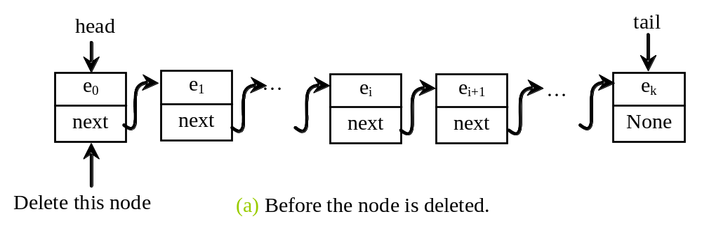
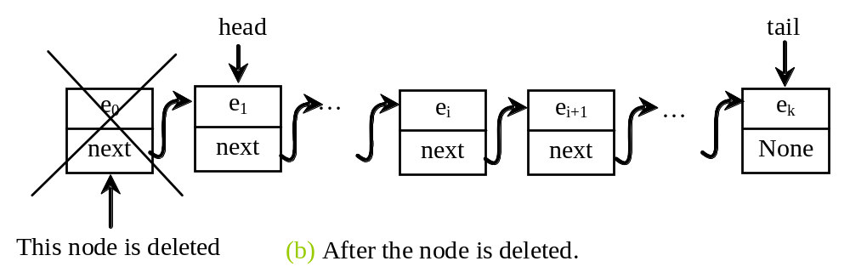
Implementing removeFirst()
def removeFirst(self):
if self.__size == 0:
return None # list is empty
else:
temp = self.__head # Store the current head node
self.__head = self.__head.next # Move the head pointer to the next node
self.__size -= 1 # Decrease the size of the list
if self.__head == None:
self.__tail = None # If the list is now empty, set tail to None
return temp.element

Slide 17
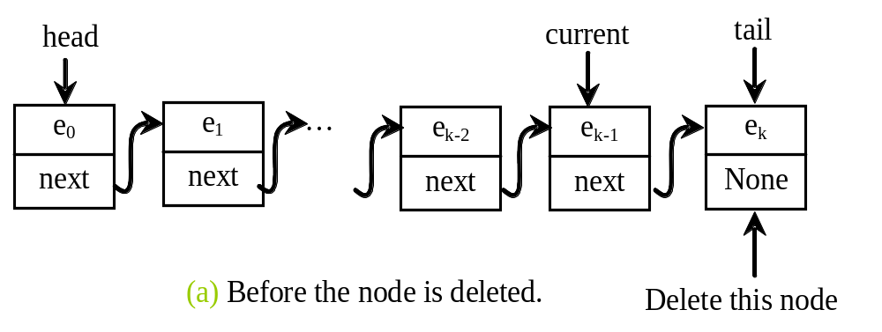
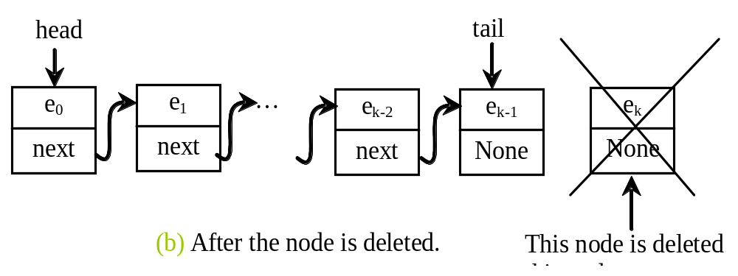
Implementing removeLast()
def removeLast(self):
if self.__size == 0: # list is empty
return None
elif self.__size == 1: # has only one node
temp = self.__head
self.__head = self.__tail = None
self.__size = 0
return temp.element
else: # has more than one node
current = self.__head # Start from the head
for i in range(self.__size - 2): # Traverse to the second last node
current = current.next
temp = self.__tail # Store the current tail node
self.__tail = current # Update the tail to the new last node
self.__tail.next = None # Set the next of new tail to None
self.__size -= 1 # Decrease the size of the list by 1
return temp.element

Slide 18
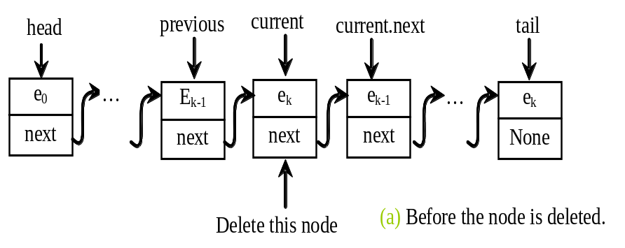
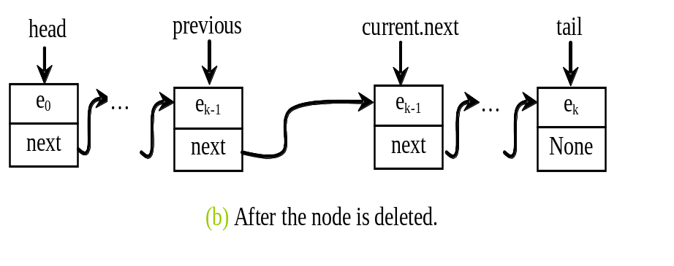
Implementing removeAt(index)
def removeAt(self, index):
if index < 0 or index >= self.__size:
return None # Out of range
elif index == 0:
return self.removeFirst() # Remove first
elif index == self.__size - 1:
return self.removeLast() # Remove last
else:
previous = self.__head # Start from the head of the list
for i in range(1, index): # Move to previous node (before the target index)
previous = previous.next
current = previous.next # Target node to be removed
previous.next = current.next # Remove the target node from the list
self.__size -= 1
return current.element

Slide 19
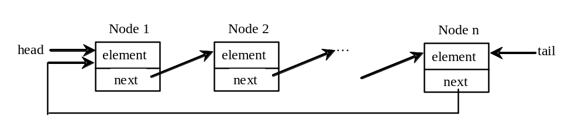
Circular Linked Lists
A circular, singly linked list is a linked list where the last node's reference points back to the first node, creating a circular structure.

Slide 20
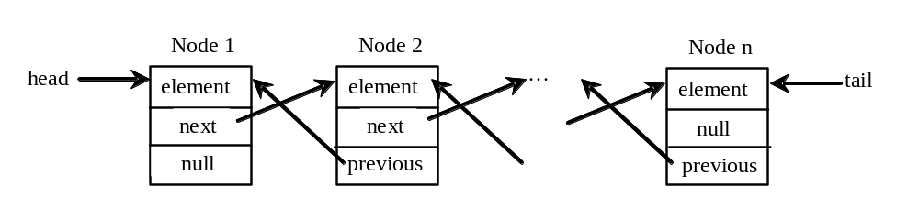
Doubly Linked Lists
A doubly linked list consists of nodes, where each node is an object containing three attributes: data, a reference to the next node, and a reference to the previous node. These references are often called the forward link and the backward link, allowing the doubly linked list to be traversed in both forward and backward directions.

Slide 21
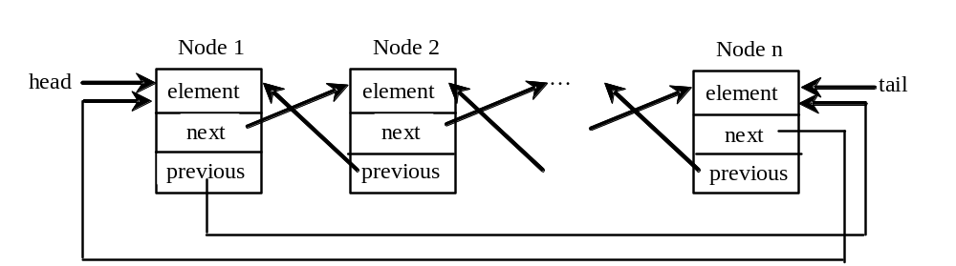
Circular Doubly Linked Lists
A circular, doubly linked list is similar to a doubly linked list, except that the next_node reference of the last node links back to the first node, and the prev_node reference of the first node links back to the last node, forming a circular structure.

Slide 22
Iterators
An iterator is an object that provides a uniformed way for traversing the elements in a container object. Recall that you can use a for loop to traverse the elements in a list, a tuple, a set, a dictionary, and a string.
For example, the following code displays all the elements in set1 that are greater than 3.
set1 = {4, 5, 1, 9}
for e in set1:
if e > 3:
print(e, end = ' ')

Slide 23
__iter__ Method
Can you use a for loop to traverse the elements in a linked list?
To enable the traversal using a for loop in a container object, the container class must implement the __iter__() method that returns an iterator as shown:
def __iter__(self):
return LinkedListIterator(self.__head)

Slide 24
__next__ Method
An iterator class must contains the __next__() method that returns the next element in the container object as shown:
class LinkedListIterator:
def __init__(self, head):
# Initialize the iterator with the head of the linked list
self.current = head
def __next__(self):
# Check if we've reached the end of the list
if self.current == None:
raise StopIteration # Signal the end of the iteration
else:
# Store the current node's element
element = self.current.element
self.current = self.current.next # Move to the next node
return element

Slide 25
__next__ Method
from LinkedList import LinkedList
lst = LinkedList() # Create a linked list
lst.add(1)
lst.add(2)
lst.add(3)
lst.add(-3)
for e in lst:
print(e, end = ' ')
print()
iterator = iter(lst) # Create an iterator
print(next(iterator))
print(next(iterator))
print(next(iterator))
print(next(iterator))
print(next(iterator))

Slide 26
Generators
Generators are special Python functions for generating iterators.
They are written like regular functions but use the yield statement to return data.

Slide 27
Generators
def fib():
fn1 = 0 # Current two consecutive fibonacci numbers
fn2 = 1
while True:
current = fn1
fn1, fn2 = fn2, fn1 + fn2
yield current # yield a Fibonacci number
def main():
iterator = fib()
# Display all Fibonacci numbers <= 10000
for i in iterator:
if i <= 10000:
print(i, end = ' ')
else:
break
main()

Slide 28
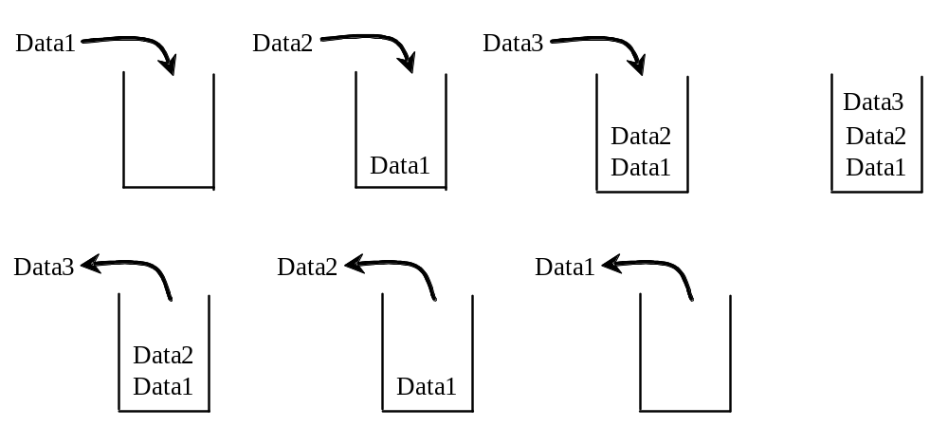
Stacks
A stack can be viewed as a special type of list, where the elements are accessed, inserted, and deleted only from the end, called the top, of the stack.

Slide 29
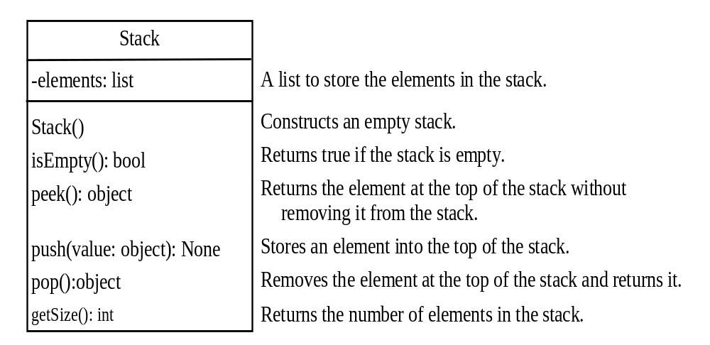
Stack

Slide 30
Stack
class Stack:
def __init__(self):
self.__elements = [] # Initialize an empty list to store stack elements
# Return true if the stack is empty
def isEmpty(self):
return len(self.__elements) == 0
# Returns the element at the top of the stack
# without removing it from the stack.
def peek(self):
if self.isEmpty():
return None # If the stack is empty, return None
else:
# Return the top element of the stack without removing it
return self.__elements[len(self.__elements) - 1]

Slide 31
Stack
# Stores an element into the top of the stack
def push(self, value):
self.__elements.append(value)
# Removes the element at the top of the stack and returns it
def pop(self):
if self.isEmpty():
return None # If the stack is empty, return None
else:
# Remove and return the top element of the stack
return self.__elements.pop()
# Return the size (number of elements) of the stack
def getSize(self):
return len(self.__elements)

Slide 32
Stack
from Stack import Stack
stack = Stack()
for i in range(10):
stack.push(i) # Push i to stack
while not stack.isEmpty():
print(stack.pop(), end = " ") # Pop from stack
[0, 1, 2, 3, 4, 5, 6, 7, 8, 9]
9 8 7 6 5 4 3 2 1 0

Slide 33
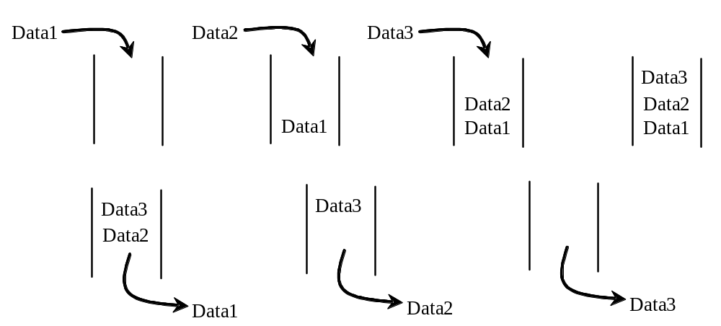
Queues
A queue represents a waiting list. A queue can be viewed as a special type of list, where the elements are inserted into the end (tail) of the queue, and are accessed and deleted from the beginning (head) of the queue.

Slide 34
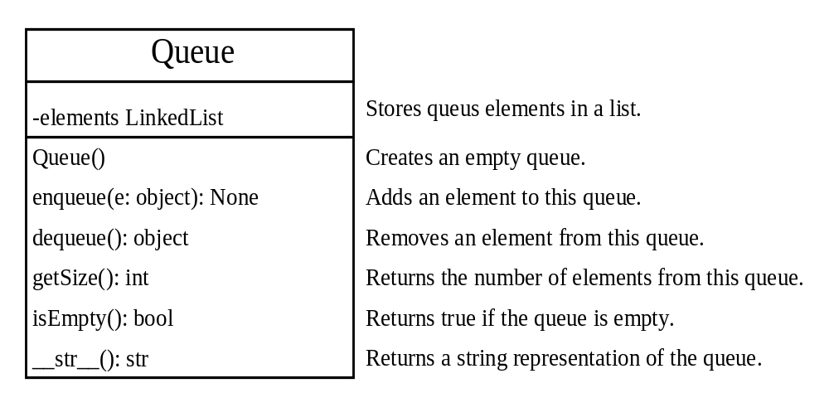
Queue

Slide 35
Queues
from LinkedList import LinkedList
class Queue:
def __init__(self):
# Initialize the queue with a linked list
self.__elements = LinkedList()
# Adds an element to this queue
def enqueue(self, e):
self.__elements.add(e) # Add element to the end of the queue

Slide 36
Queues
# Removes and returns the front element of the queue
def dequeue(self):
if self.getSize() == 0:
return None # If queue is empty, return None
else:
return self.__elements.removeAt(0) # Remove the front element
# Return the size of the queue
def getSize(self):
return self.__elements.getSize()
# Returns a string representation of the queue
def __str__(self):
return self.__elements.__str__()
# Return true if queue is empty
def isEmpty(self):
return self.getSize() == 0

Slide 37
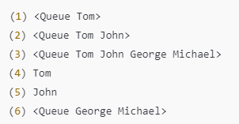
Queues
from Queue import Queue
queue = Queue() # Create a queue
# Add elements to the queue
queue.enqueue("Tom") # Add Tom to the queue
print("(1)", queue)
queue.enqueue("John") # Add John to the queue
print("(2)", queue)
queue.enqueue("George") # Add George to the queue
queue.enqueue("Michael") # Add Michael to the queue
print("(3)", queue)
# Remove elements from the queue
print("(4)", queue.dequeue())
print("(5)", queue.dequeue())
print("(6)", queue)

Slide 38
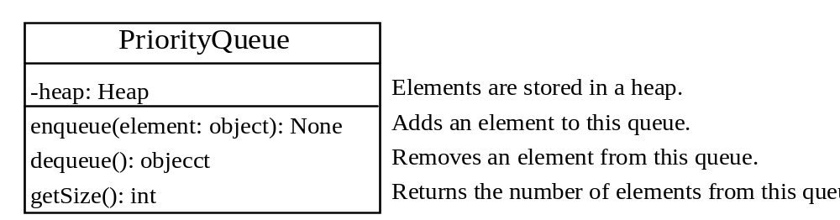
Priority Queue
A regular queue is a first-in and first-out data structure. Elements are appended to the end of the queue and are removed from the beginning of the queue.
In a priority queue, elements are assigned with priorities. When accessing elements, the element with the highest priority is removed first.
A priority queue has a largest-in, first-out behavior. For example, the emergency room in a hospital assigns patients with priority numbers; the patient with the highest priority is treated first.

Slide 39
Priority Queue
from Heap import Heap
class PriorityQueue:
def __init__(self):
self.__heap = Heap() # Initialize with a heap
# Adds an element to this queue
def enqueue(self, e):
self.__heap.add(e) # Add element to the priority queue using the heap
# Removes an element from this queue
def dequeue(self):
if self.getSize() == 0:
return None # If queue is empty, return None
else:
return self.__heap.remove() # Remove the element with the highest priority
# Return the size of the queue
def getSize(self):
return self.__heap.getSize()

Slide 40

Priority Queue
from PriorityQueue import PriorityQueue
patient1 = [2, "John"] # Patient with priority 2
patient2 = [1, "Jim"] # Patient with highest priority as 1
patient3 = [5, "Tim"]
patient4 = [7, "Cindy"] # Patient with priority 7
priorityQueue = PriorityQueue() # Create a PriorityQueue instance
priorityQueue.enqueue(patient1) # Enqueue patient1
priorityQueue.enqueue(patient2)
priorityQueue.enqueue(patient3)
priorityQueue.enqueue(patient4)
while priorityQueue.getSize() > 0:
print(priorityQueue.dequeue(), end = " ") # Dequeue and print the patient

